Slide 1

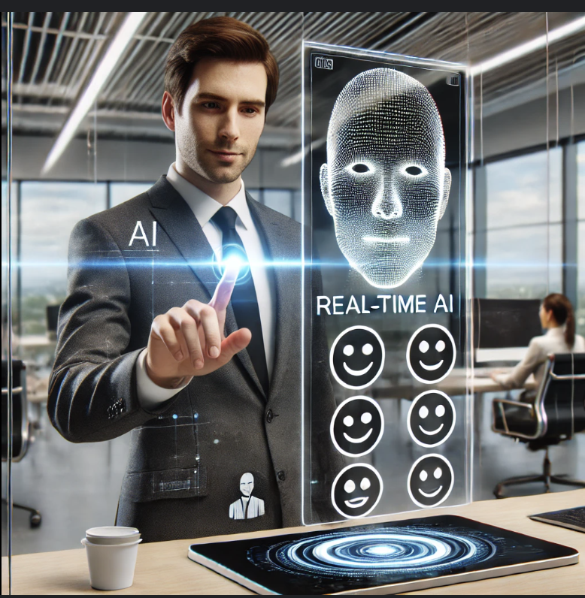
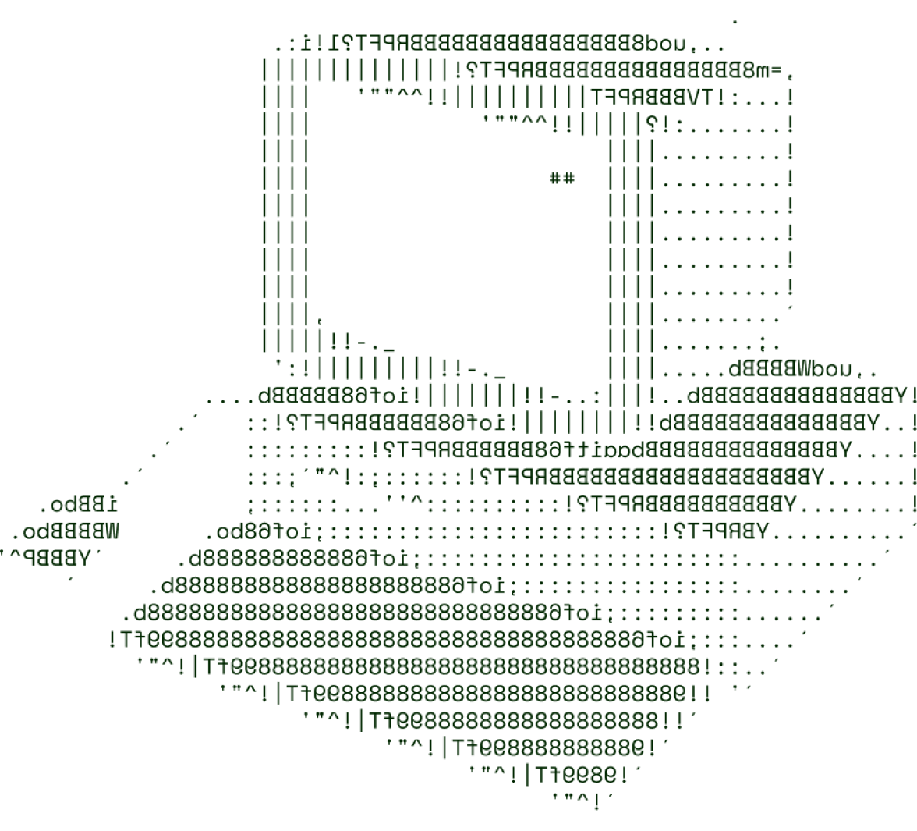

Real-Time Emotional Companion for Remote Workers
INNOVATORS

Slide 2

Solution Overview
Remote workers often face isolation, stress, and lack of emotional support . Decline in mental well-being leads to decreased productivity and burnout.
Solution : AI-driven virtual assistant that monitors emotional well-being . Uses facial recognition, voice analysis, and behavioral tracking . Provides real-time feedback and personalized mental health interventions .
Features : Detects stress, fatigue, and other emotional states . Offers proactive suggestions (e.g., breaks, breathing exercises).Integrates with communication platforms (e.g., Zoom, Slack).
Impact: Boosts productivity . Reduces emotional burnout . Enhances work-life balance .
Visual Ideas : Emotional spectrum icons (e.g., happy, stressed, neutral).Flowchart showing problem, assistant detection, real-time feedback, outcome.

Slide 3
Technical Architecture Overview
Frontend : React, Angular, or Vue.js for a responsive user interface . Real-time video and voice integration for emotion tracking .
Backend : Node.js , Django, or Flask for emotion recognition algorithms . Processes real-time user interactions and APIs .
Database : MySQL, MongoDB, or PostgreSQL for storing emotional data . Optimized queries for user insights and history .
Tools/Services : Docker for containerization . AWS for scalable cloud services . Git for version control and team collaboration .
Visual Ideas : High-level diagram of the system architecture: Frontend, backend, database, cloud services . Flow of data from user interactions through processing to insights.

Slide 4
SCALABILITY
Handling Increased Traffic : Cloud services (AWS/Google Cloud) dynamically scale resources . Load balancing ensures efficient traffic distribution . Microservices Architecture :Breaks down the system into independent services (emotion detection, user feedback, analytics).Each service scales independently, improving flexibility and fault tolerance .
Containerization : Docker ensures consistent environments across machines . Kubernetes automates container management, scaling services based on real-time demand .
Elasticity : Automatic scaling based on workload . Ensures high availability and performance under heavy loads.
Visual Ideas : Cloud diagram showing dynamic scaling, load balancers . Docker container and Kubernetes node illustrations.

Slide 5
FUTURE SCOPE
AI-Driven Emotional Analytics : Advanced machine learning models will improve the accuracy of emotional predictions . Personalized emotional patterns learned over time, offering proactive suggestions .
Wearable Device Integration : Integrating with devices like smartwatches for biometric data (heart rate, sleep).Enhances the assistant’s emotional tracking with physical health data .
Multilingual Support : Expand the platform with natural language processing (NLP) for multiple languages . Accessible to users across different regions, ensuring inclusivity .
New Use Cases : Expand into corporate wellness programs, integrating with HR tools. Real-time emotional monitoring for online education and remote therapy.
Visual Ideas : Timeline showing feature roll-out . Iconography for AI, wearable tech, multilingual NLP.

Slide 6
FEASIBILITY
1. Technological Feasibility :
Proven Tech Stack: React, Node.js, Django, AWS ensure reliable development.
AI Availability: Pre-trained emotion recognition models reduce development time.
2. Financial Feasibility:
Cost-Effective: Initial costs are minimized with pay-as-you-go cloud services (AWS, GCP).
Open Source Tools: Use of free frameworks (e.g., Docker, Git) lowers expenses.
3. Operational Feasibility : Cloud-Based: Minimal infrastructure management, automatic scaling, and backups .
Ease of Development: Familiar tech stack reduces the learning curve and speeds up deployment.
4. Market Feasibility : Demand Growth: Mental health solutions are in demand, especially for remote workers .
Partnerships: Integration potential with Slack, Teams, and wearable tech.
5. Legal & Ethical Feasibility :
Data Privacy: Compliant with GDPR and global privacy regulations.
Ethical AI: Fair, transparent emotional tracking to avoid biases.

Slide 7


>Team INNOVATORS

Slide 8




Name: P. GNANA DEEPAK VARDHAN
Name: K.J.V. SANDEEP
CEO
CTO
Name: T. PAVANI
CDO

Slide 9

THANK YOU

